Slide 1


What is child-on-child abuse?

Slide 2
A child might be a someone in your class, someone from another
class or someone you know outside of school.
Abuse is something which usually hurts another person, emotionally
or physically, and is done on purpose to scare, hurt or upset that
person.
Sometimes, it can be hard to know when abuse is happening,
because not all abuse will hurt, scare or upset you.
You might also, not know it is happening.
It is really important to know when you are being abused so
that we can make sure it stops.

Slide 3

Bullying

Slide 4
Bullying is behaviour that hurts someone else.
It includes name calling, hitting, pushing, spreading
rumours, threatening or undermining someone (NSPCC).
Bullying is usually targeted and repetitive.

Slide 5
Emotional bullying – this is when someone’s feelings are hurt by leaving them
out, being unkind, being mean or being bossy.
Physical bullying – this is where someone is physically hurt through punching,
kicking, spitting, hitting or pushing.
Verbal bullying – this is when someone teases a person. They may call them
names or use rude hand signs. They may also be sexist, racist, homophobic or
transphobic.
Cyber bullying – this is when someone sends horrible messages over the
internet or by text message. This might be on a game or on a phone.
Bullying might not always be done to someone’s face, sometimes they might
not know it is happening. It might also be done through another person – by
one person sending another person to say to do nasty things

Slide 6
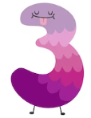
Social Media

Slide 7
Many children use social media such as Snapchat, WhatsApp and TikTok.
Although these Apps are a good way to stay in contact with your friends they
can be used to cause people harm.
This might be sending inappropriate selfies, pictures, videos or messages
about private parts.
Pressuring someone into sending these pictures or videos and messages is
abuse.
Even if you are not the person who is sending them, it is illegal to have these
kinds of pictures, or videos, if the person is under 18.

Slide 8

Sexual Harassment/Abuse

Slide 9
In school we all know the PANTS rule from the NSPCC . We learn about this in class every year.
Sometimes, people can act inappropriately towards others and it might make them feel
uncomfortable.
This can happen online, on social media, through messages or face-to-face.
It might make you feel scared, embarrassed, uncomfortable or upset.
It could be:
Someone making sexual comments – this is telling sexual stories, saying rude things
or saying sexual things about someone’s appearance or clothes.
Calling someone sexual names.
Sexual jokes about your body parts.
Being physical – this is any touching which makes you feel uncomfortable,
messing with your clothes, or showing pictures or drawings which are of a sexual nature.

Slide 10
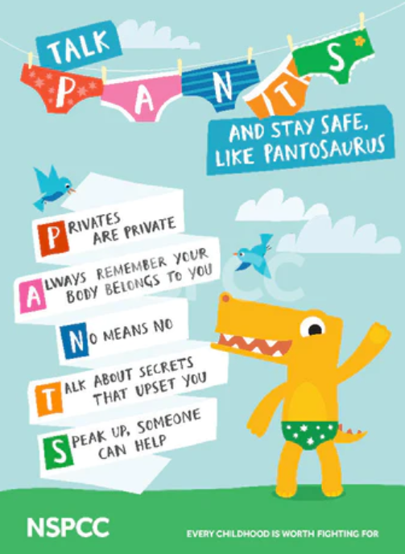

Slide 11

Relationships

Slide 12
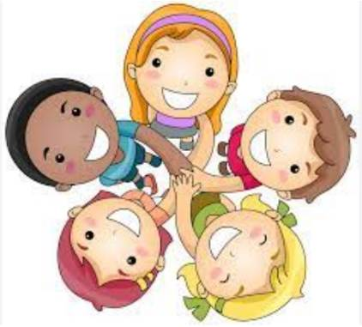
Any relationship you have should be good and happy.
A bad relationship might make someone feel scared, confused,
worried and even unsafe.
It is really important to know what good and bad relationships look
like.

Slide 13
Good Relationships
You are comfortable around that person
You can be honest with them
You can say how you feel and they listen to you
You support each other and treat each other nicely
You feel safe with them
You trust them
You are equal – you don’t boss each other around
You feel looked after

Slide 14
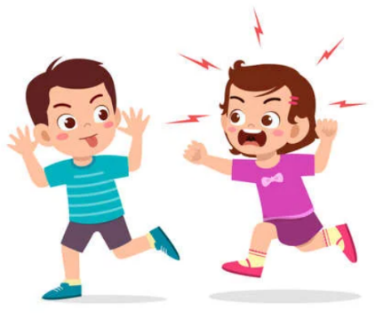
Bad Relationships
They might push you, hit you or destroy your things
They might tell you what to do, what to wear or who you can
see
You might feel scared – they might say they will hurt you if you
don’t do something
They might call you names and make you feel bad about
yourself in front of other people
They might get angry easily and you might not know why –
sometimes it makes you feel nervous
They might pressure you to do things you don’t want to
They might not take no for an answer when you say you don’t
want to do something

Slide 15

How do I know if
someone is being
abused?

Slide 16
It might be hard to know if you are being abused and you might not really understand it is happening.
It is important that you recognise when behaviour isn’t
appropriate.
It is also important that you can notice when it might
be happening to someone else.

Slide 17
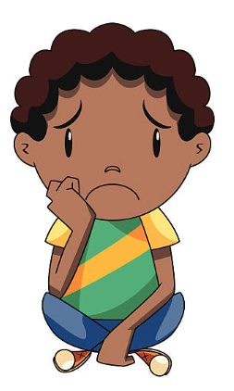
Not going to school
Having injuries, like bruises
Feeling sad or down
Feeling like they can’t cope
Feeling withdrawn and shy – not wanting to play
Getting headaches and stomach aches
Feeling nervous
Having difficulty sleeping
Feeling panicked
Using alcohol or drugs
Changing how they look so that they look much older
Being abusive to someone else
Remember: You might feel all of these things too. Listen to how you feel.

Slide 18

What do I do if someone else if
being abused?

Slide 19
If you recognise any of the signs or you see someone being abused, it is important that you help that person.
You should never walk away and ignore the problem because it might keep happening.
If it is safe to do so, tell the person abusing to stop
Tell a grown up as soon as you know something is wrong
Grown ups can stop the abuse and make the person feel happy again.
You should never feel scared to tell someone about abuse.
If you are worried about someone, but you aren’t sure, still tell an adult – it is important to share with an adult if you are worried about a person.
In school, you can tell your teacher, someone off your helping hand or a member of the safe-guarding team.

Slide 20

What do I do if
I am being abused?

Slide 21
The first thing you should do is tell someone you trust – a family member, a friend, a teacher, someone on your helping hand.
You can also tell the person abusing you to leave you alone. If telling them would make you feel scared or worried that they might hurt you, make sure you tell someone else so that they can help you.
You should try not to:
Do what the person says
Let what the person says or does upset you
Get angry or hit them
You shouldn’t be scared to talk to someone – a grown-up can make the abuse stop.
Remember: If you are being abused it is not your fault and you are never alone.

Slide 22

Who can I talk to?

Slide 23
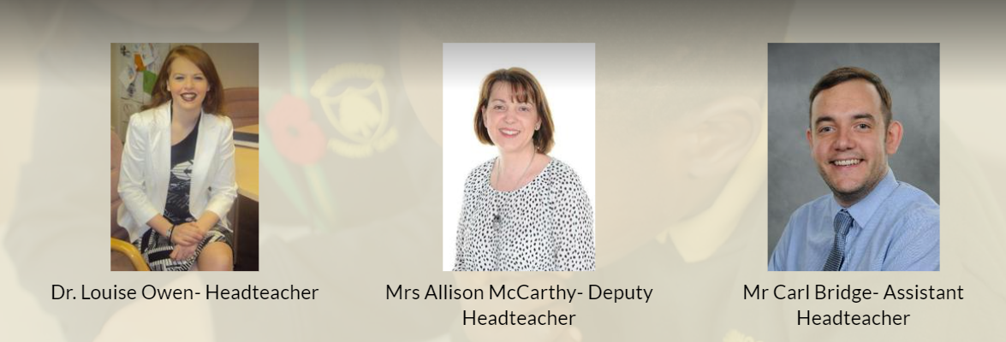
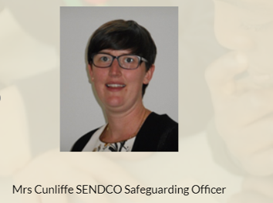


It is important to tell someone if you, or someone you know, is being abused.
Speak to someone like your mum, dad, carer or teacher – adults can really help to make the abuse stop.
Here are some people you can talk to, in and out of school.

Slide 24


How can I stop abuse
from happening?

Slide 25
We can all work together at our school to stop abuse from happening.
We can do this by:
Learning about child-on-child abuse
Talking to someone when we are worried
Living our Core Values of;
              Togetherness
              Respect
              Welcoming
              Commitment
              Nurturing

